Slide 1



Slide 2
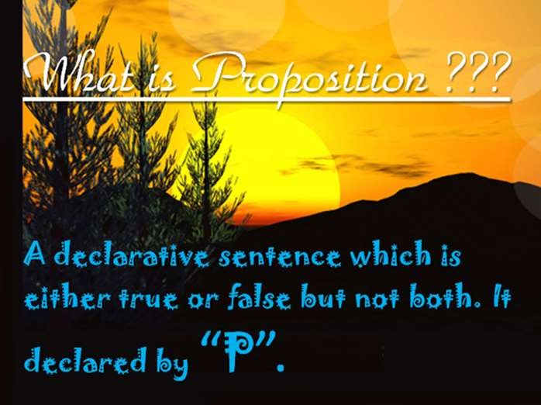

Slide 3
Propositions
So why waste time on such matters? Propositional logic is the study of how simple propositions can come together to make
more complicated propositions. If the simple propositions were endowed with some meaning –and they will be very soon– then the complicated proposition would have meaning as well, and then finding out the truth value is actually important!
3

Slide 4
False, True, Statements
False is the opposite to Truth.
A statement is a description of something.
Examples of statements:
I’m 31 years old.
I have 17 children.
I always tell the truth.
I’m lying to you.
4

Slide 5
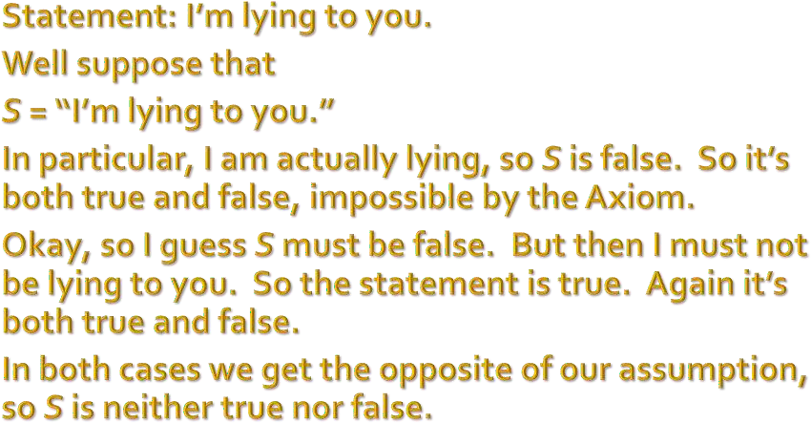
False, True, Statements
5

Slide 6
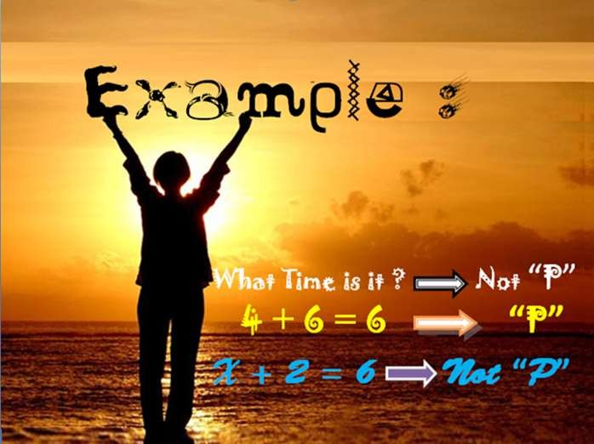

Slide 7

Another example of proposition
I worked hard or I played the piano(W˅P).
If I worked hard, then I will get a bonus
(W⇒B).
I did not get a bonus¬(B).

Slide 8


Compound Propositions
In Propositional Logic, we assume a collection of atomic propositions are given: p, q, r, s, t, ….
Then we form compound propositions by using logical connectives (logical operators) to form propositional
“molecules”.
8

Slide 9

 | Symbol | Usage
Negation | ¬ | not
Conjunction | ∧ | and
Disjunction | ∨ | or
Exclusive or | ⊕ | xor
Conditional | → | If , then
Biconditional | ↔ | iff
9

Slide 10

Compound Propositions: Examples
p = “Cruise ships only go on big rivers.”
q = “Cruise ships go on the Hudson.”
r = “The Hudson is a big river.”
¬r = “The Hudson is not a big river.”
p∧q = “Cruise ships only go on big rivers and go on the Hudson.”
p∧q →r = “If cruise ships only go on big rivers and go on the Hudson, then the Hudson is a big
river.”
10

Slide 11

Precedence of Logical Operators:
1.Negation (¬) 2.Conjunction (∧) 3.Disjunction (∨) 4.Implication (→) 5.Biconditional (↔)

Slide 12


Slide 13


Logical Connective: Logical And
The logical connective And is true only when both of the propositions are true. It is also called a conjunction
Examples
It is raining and it is warm
(2+3=5) and (1<2)

Slide 14



Logical Connective: Logical And
p | q | P ∧ q
T T F F | T F T F | T F F F
14

Slide 15











































Slide 16


p | q | p∨q
T T F F | T F T F | T T T F
Lecture 1
16

Slide 17




The exclusive OR, or XOR, of two propositions is true when exactly one of the propositions is true and the other one is false
Example
The circuit is either ON or OFF but not both
Let ab<0, then either a<0 or b<0 but not both
You may have cake or ice cream, but not both

Slide 18

Logical Connective: Exclusive Or
p | q | p ⊕q
T T F F | T F T F | F T T F
18

Slide 19

Definition: Let p and q be two propositions. The implication p→q is the proposition that is false when p is true and q is false and true otherwise
p is called the hypothesis, antecedent, premise
q is called the conclusion, consequence

Slide 20
P | Q | P⇒Q
t | t | t
t | f | f
f | t | t
f | f | t
In General statement: if p then q converse: if q then p
inverse: if not p then not q contrapositive: if not q then not p
20

Slide 21
Logical Connective: Biconditional
Definition: The biconditional p↔q is the proposition that is true when p and q have the same truth values. It is false otherwise.

Slide 22








p
q
p ↔ q
22

Slide 23
TAUTOLOGY
A compound proposition that is always true is called tautology .

Slide 24
Example Of Tautology
P | ¬P | P v¬P
T | F | T
F | T | T

Slide 25
CONTRADICTION
A compound proposition which is always false is called contradiction.

Slide 26
Table of contradiction
P | ¬P | P^P
T | F | F
F | T | F

Slide 27

Example of Tautology by logical equivalence
(p^q)-->(pvq)= ¬(p^q) v (pvq)
= (¬pv¬q) v (pvq)
= (¬pvp) v (¬qvq)
= T v T
= T

Slide 28
THANKS TO ALL FOR YOUR KIND ATTENTION AND SUPPORT

